Slide 1




INTRODUCTION TO
RELATIONAL ALGEBRA
Intro into Database Management – Page 3 – Programmer Prodigy

Slide 2
Relational Algebra
The relational algebra is a procedural query language
It consists of a set of operations that take one or two relations as input and produce a new relation as their result.
These operations enable a user to specify basic
retrieval requests (or queries)

Slide 3
Cont.
The fundamental operations in the relational algebra are select, project, union, set difference, Cartesian product, and rename
The select, project, and rename operations are called unary operations, because they operate on one relation
The other three operations operate on pairs of relations and are, therefore, called binary operations

Slide 4
Unary Relational Operations
SELECT (symbol: σ (sigma))
Selects a subset of rows from relation
PROJECT (symbol: π (pi))
Selects columns from relation
RENAME (symbol: ρ (rho))

Slide 5
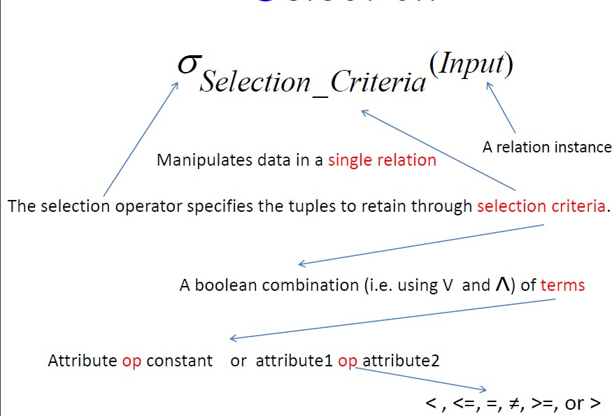
SELECTION

Slide 6
EXAMPLE
Select the EMPLOYEE tuples whose department number is 4:
σ _{DNO = 4} (EMPLOYEE)
Select the employee tuples whose salary is greater than
$30,000:
σ
SALARY > 30,000 ^{(EMPLOYEE)}
Select the instructors in Physics with a salary greater than $90,000, (and (∧), or (∨), and not (￢))
σ dept name =“Physics” ∧ salary>90000 (instructor )

Slide 7
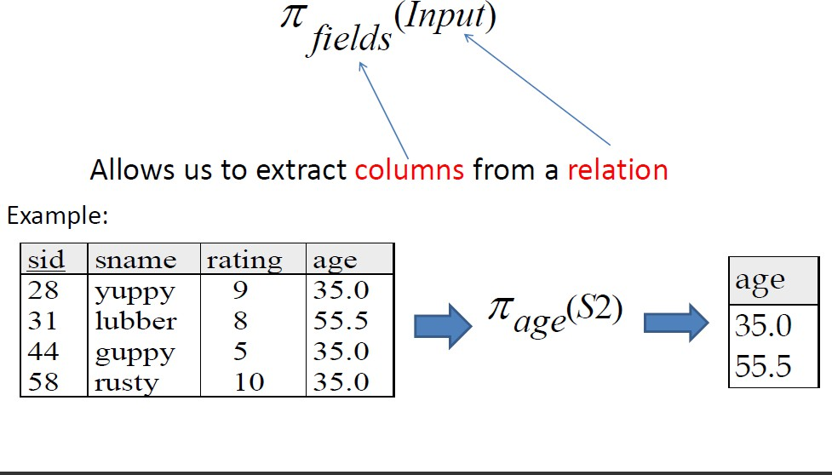
PROJECTION
extracting the values of specified attributes and​ eliminating duplicates.​

Slide 8
EXAMPLE
Example: To list each employee’s first and last name and salary, the following is used:
^{π}LNAME, FNAME,SALARY^{(EMPLOYEE)}

Slide 9
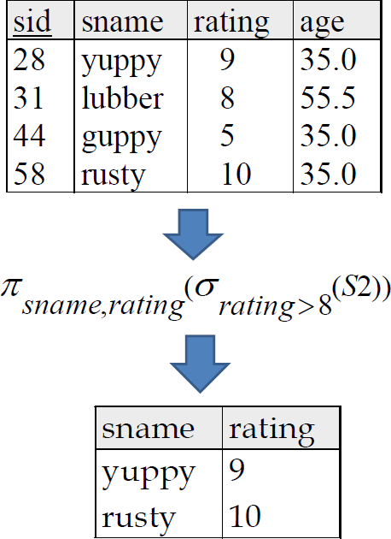
Composition of Relational Operations

Slide 10
Example
“Find the name of all instructors in the Physics department.
π name (σ dept name =“Physics”
(instructor))

Slide 11
RENAME
The general RENAME operation ρ can be expressed by any of the following forms:
ρ_{S}(R) changes:
the relation name only to S
ρ_{(B1, B2, …, Bn )}(R) changes:
the column (attribute) names only to B1, B1,
…..Bn
ρ_{S (B1, B2, …, Bn )}(R) changes both:
the relation name to S, and
the column (attribute) names to B1, B1, …..Bn

Slide 12
Relational Algebra Operations Set Theory
Union
Intersection
Set Difference / Minus
Cartesian Product

Slide 13
UNION
It is a Binary operation, denoted by ∪
The result of R ∪ S, is a relation that includes all tuples that are either in R or in S or in both R and S
Duplicate tuples are eliminated.

Slide 14

UNION
– The two operand relations R and S must be “type compatible” (or UNION compatible)
Two relations are union compatible if
Relation R and S should have same arity, Both have same number of columns
Names of attributes and the domain type are the same in both

Slide 15


Example
Tables:
Person (SSN, Name, Address, Hobby) Professor (Id, Name, Office, Phone)
are not union compatible. However
Π _{Name} (Person) and Π _{Name} (Professor) are union compatible and
15

Slide 16
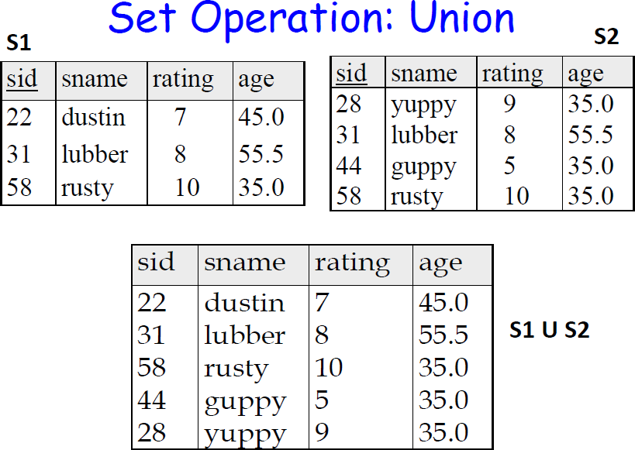

Slide 17
INTERSECTION
INTERSECTION is denoted by ∩
The result of the operation R ∩ S, is a relation that includes all tuples that are in both R and S
– The attribute names in the result will be the same as the attribute names in R
The two operand relations R and S must be “type compatible

Slide 18
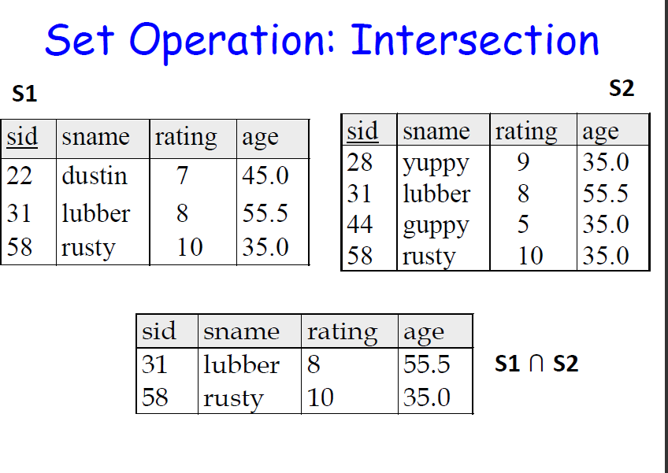

Slide 19
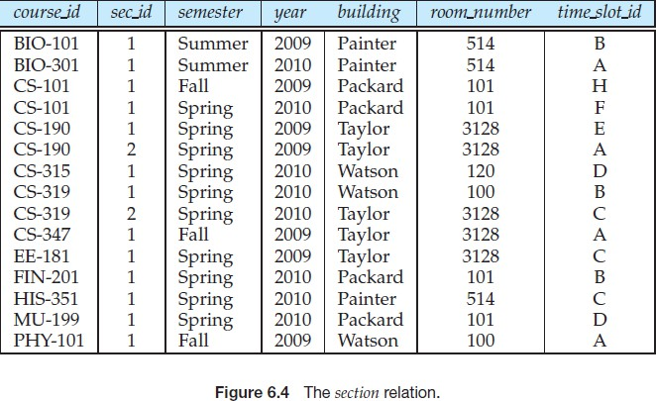

Slide 20

Consider a query to find the set of all courses taught in the Fall 2009 semester, the Spring 2010 semester, or both
To find the set of all courses taught in the particular year, we

Slide 21
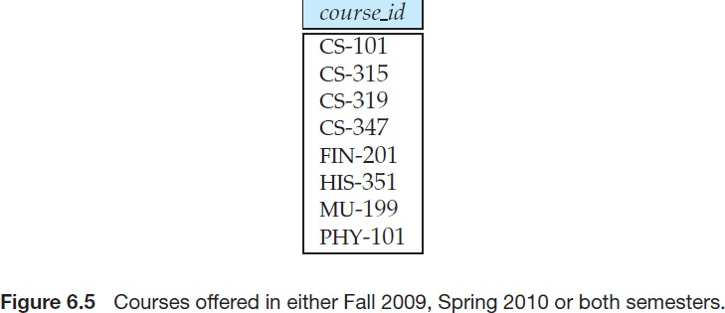

Slide 22
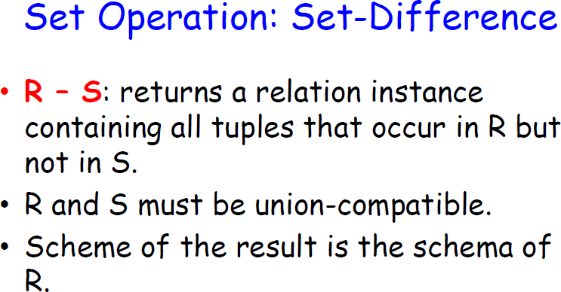

Slide 23
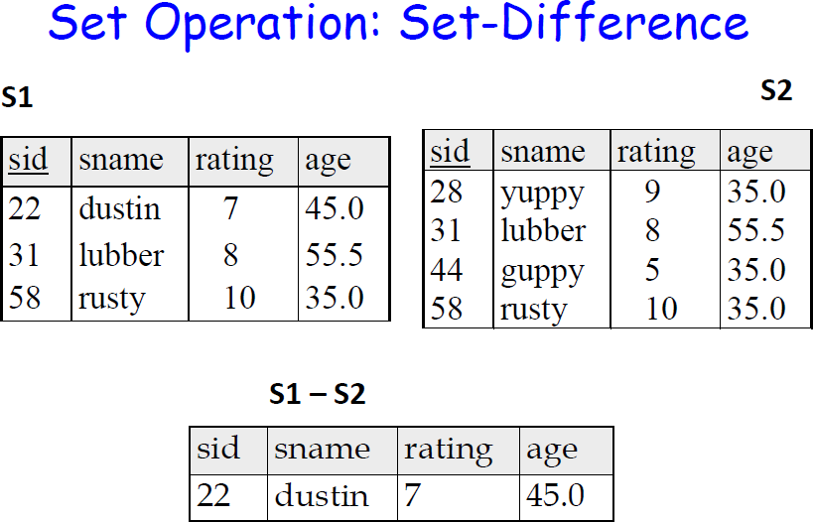

Slide 24


We can find all the courses taught in the Fall 2009 semester but not in Spring 2010 semester by writing:

Slide 25
Cartesian-Product Operation
Denoted by x
Also known as product or cross-join
Notation r x s
Combines tuples members of one relation to other relation
R (a1, a2 … an) x S(b1, b2 … bn)
– T (a1, a2 … an, b1, b2 … bn)
If we need the all borrowers and loan holder in chennai
σ branch = “chennai” (borrower x loan)

Slide 26
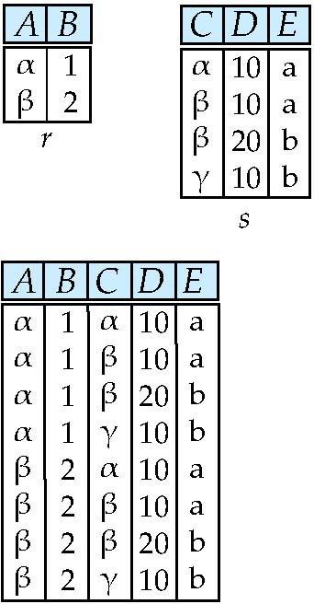
Cartesian-Product Operation
Relations r, s:
r x s:

Slide 27
SQL Built in Functions
NUMERIC FUNCTIONS:
abs(n) – returns absolute value of n
SQL> select abs(-2) from dual; - 2
ceil(n) – ceil(3.78) - 4
floor(n) – floor(2.4) - 2
sqrt(n)
power(n,m)
SQL> select power(5,2) from dual; - 25
mod(a,b)
cos(n)

Slide 28
SQL Built in Functions
String/Character FUNCTIONS:
initcap(string)
SQL > select initcap(‘hello’) from dual; - Hello
upper(string)
lower(string)
ltrim(string)
SQL > select ltrim(‘
rtrim(string)
replace( )
hello’) from dual; - hello
SQL > select replace(‘hello’, ’ll’, ’r’) from dual; - hero
length( )
SQL > select length(‘hello’) from dual; - 5

